Slide 1


"Intelligent Parallel Code Generation Using Modern Compiler Techniques"
Presented by:
M . Vaishnavi (192372203) (Department of CSE)
Institution:
Saveetha Institute of Medical and Technical Sciences
Course:
Compiler Design for industrial Automation(CSA1429)
Supervisor:
Dr. G. Michael (Department of Computational Data Science )

Slide 2
Introduction
.
Need for Parallel Computing: Modern processors are designed with multiple cores to handle increasing computational demands. However, most programs are still written in a sequential manner, limiting their ability to take full advantage of multi-core architectures. Efficient parallelization is essential to improve execution speed and overall system performance
Challenges in Manual Parallelization: Writing parallel code manually requires expertise in concurrency, task scheduling, and dependency management. Manual parallelization is complex, time-consuming, and prone to errors such as race conditions and deadlocks, making it challenging for developers to fully optimize code for parallel execution.
Limitations of Traditional Compilers: Existing compilers often lack the capability to automatically analyze and convert sequential code into parallel code effectively. They struggle with identifying complex dependencies and generating efficient task schedules, leading to underutilization of available processing power..

Slide 3
Problem Statement
Sequential Code Limitations: Most programs are written in a sequential manner, which limits their execution speed and efficiency on modern multi-core processors.
Manual Parallelization Complexity: Converting sequential code to parallel code manually is complex, error-prone, and time-consuming.
Dependency Issues: Identifying dependencies and data races accurately is challenging, which can lead to incorrect or inefficient parallel execution.
Compiler Limitations: Traditional compilers are limited in their ability to automatically generate optimized parallel code.
Performance Bottlenecks: Without effective parallelization, programs fail to leverage the full potential of multi-core architectures, leading to suboptimal performance.
Need for Automation: There is a need for an intelligent system that can automate the parallelization process using modern compiler techniques to improve execution speed and resource utilization.

Slide 4
Purpose of the Project
Automate Parallelization: To develop a system that automatically converts sequential code into optimized parallel code using modern compiler techniques.
Improve Performance: To enhance the execution speed and efficiency of programs by enabling better utilization of multi-core processors.
Reduce Complexity: To simplify the process of parallel programming by minimizing the need for manual intervention and reducing the chances of errors.
Optimize Resource Utilization: To ensure that computational resources are effectively used, leading to improved overall system performance.
Optimization of Code Execution: The project aims to enhance the performance of programs by using advanced compiler techniques to automatically generate parallelized code, improving execution speed and efficiency, especially for computationally intensive tasks.
Intelligent Decision-Making: By employing intelligent algorithms, the project seeks to analyze the structure of code and automatically identify parts that can be parallelized, thereby reducing the manual effort required for developers to optimize parallelism in their programs.

Slide 5
Objectives
Develop an Automated System: Create a compiler-based system that can analyze and convert sequential code into efficient parallel code.
Enhance Code Efficiency: Implement modern compiler techniques to optimize task scheduling and dependency handling for improved execution speed.
Minimize Errors: Reduce data races, deadlocks, and other concurrency issues through accurate dependency analysis and intelligent code generation.
Maximize Processor Utilization: Ensure effective use of multi-core processors to achieve better performance and resource management.
Automating Parallelization: To develop an intelligent system that automatically identifies opportunities for parallel execution in sequential code, thereby enhancing performance without requiring manual intervention from developers.
Improving Compiler Techniques: To apply modern compiler optimization strategies, such as data dependency analysis and parallel execution models, to generate highly efficient parallel code for a wide range of applications.

Slide 6
Literature Review
Parallel Computing Techniques: Research has shown that parallel computing significantly improves performance by dividing tasks among multiple processors, but manual parallelization remains complex and error-prone.
Compiler-Based Parallelization: Studies highlight that modern compiler frameworks like LLVM and GCC have introduced techniques for automatic dependency analysis and loop transformation to enable parallel execution.
Dependency and Race Condition Handling: Existing research focuses on improving dependency detection and minimizing data races using static and dynamic analysis, but challenges remain in balancing accuracy and performance.
Optimization Strategies: Various approaches, such as task scheduling, loop unrolling, and vectorization, have been explored to maximize processor utilization, but integrating these techniques into an automated system remains an active area of research.

Slide 7
Research Gap
Limited Automation: Existing compilers lack fully automated systems that can efficiently convert complex sequential code into optimized parallel code without manual intervention
Dependency Handling Challenges: Current techniques for dependency analysis and race condition prevention are not accurate enough for complex programs, leading to potential performance issues.
Task Scheduling Inefficiencies: Existing scheduling strategies often fail to adapt to dynamic workloads, resulting in underutilization of processor resources.
Lack of Comprehensive Optimization: While individual optimization techniques like loop unrolling and vectorization exist, there is a gap in integrating them into a unified, intelligent parallel code generation system. .
Limited Automation in Parallelization: Existing compilers often require manual intervention or rely on basic heuristics for parallel code generation, leaving a significant gap in fully automating the process while maintaining high performance and correctness across diverse application types.

Slide 8
Methodology
Code Analysis: Analyze the input sequential code to identify independent tasks, dependencies, and potential data races using static and dynamic analysis techniques.
Dependency Resolution: Apply modern compiler techniques to resolve data dependencies and eliminate race conditions through loop transformation and task synchronization.
Parallel Code Generation: Generate optimized parallel code using compiler frameworks like LLVM, ensuring efficient task scheduling and load balancing.
Performance Evaluation: Test the generated parallel code on different multi-core architectures, measure execution speed, and adjust optimization strategies to maximize performance.
Code Analysis and Parallelism Detection: The compiler uses static and dynamic analysis to identify independent tasks or loops in the sequential code that can be parallelized, ensuring accurate identification of code segments that can benefit from parallel execution.

Slide 9
Technology Stack
Programming Languages: Use C and C++ for implementing the compiler components and parallel code generation.
Compiler Framework: Leverage LLVM for code analysis, transformation, and optimization.
Parallel Programming Models: Use Open MP and MPI for implementing task parallelism and inter-process communication.
Development Tools: Utilize Visual Studio Code for coding and debugging, along with performance profiling tools for optimization analysis.
Compiler Frameworks and Tools: Use of modern compiler infrastructures like LLVM or GCC, which provide the necessary components for code analysis, optimization, and code generation, enabling the integration of advanced techniques for parallelization.
Machine Learning Algorithms: Implementing machine learning models, such as reinforcement learning or deep learning, to intelligently predict and optimize parallel execution patterns based on code structure and hardware configurations.

Slide 10
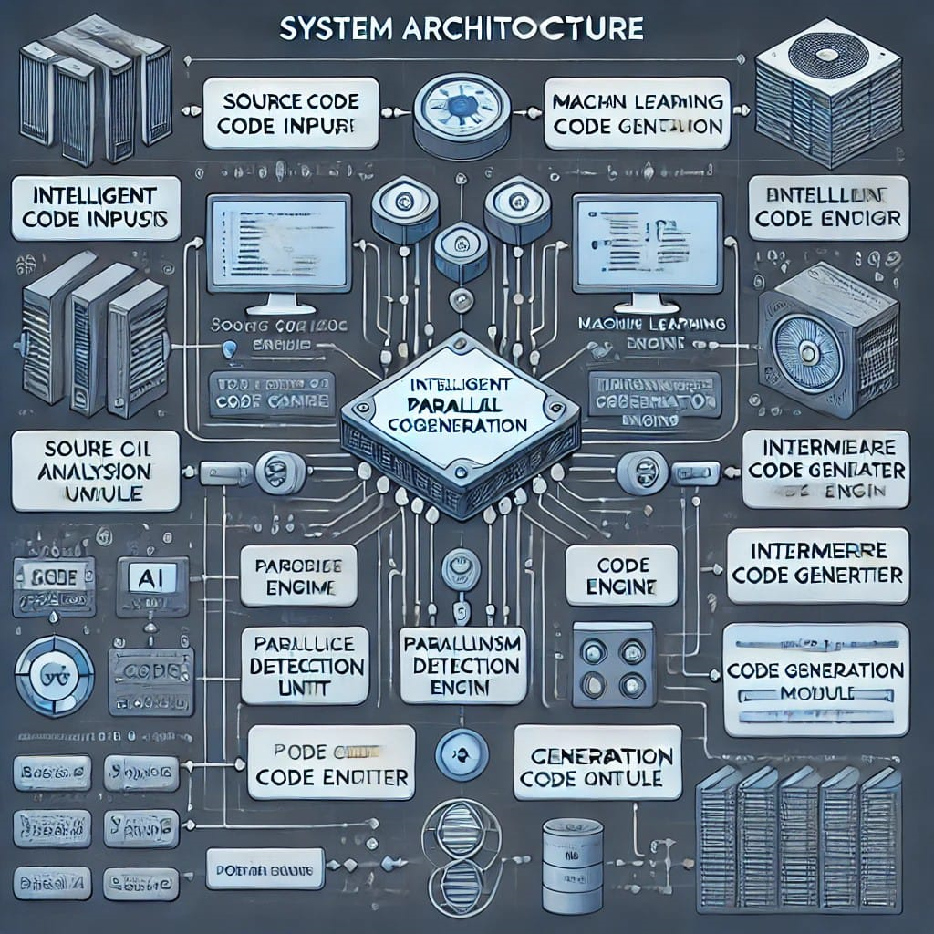
System Architecture
AI-Powered Analysis Module: This module uses machine learning algorithms to detect parallelization opportunities by analyzing code patterns and dependencies.
Optimization Engine: After intermediate code generation, the optimization engine applies parallel execution strategies, ensuring efficient resource utilization.
Parallelism Detection Unit: It evaluates code structures and suggests possible parallel paths, reducing execution time and enhancing computational.

Slide 11
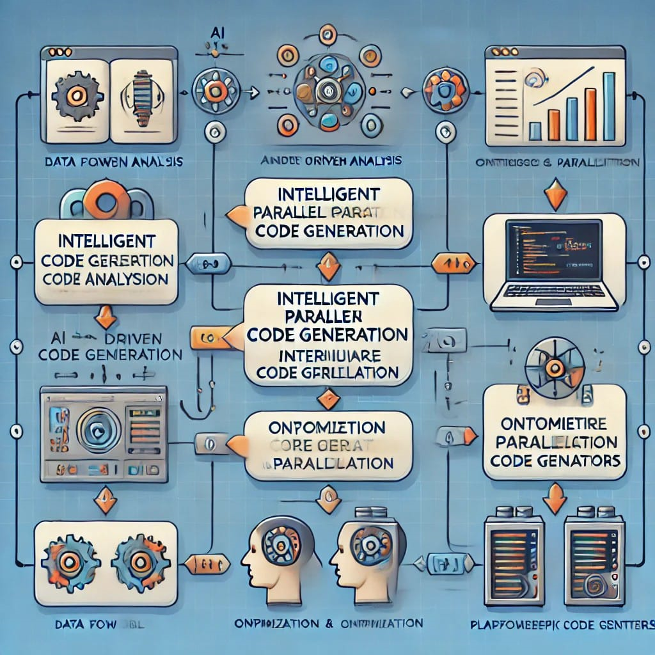
Implementation
AI-Driven Analysis: Implement AI models to analyze source code, identify dependencies, and detect opportunities for parallelism. Machine learning algorithms are trained using historical code patterns.
Intermediate Code Generation: Convert the source code into an intermediate representation (IR) for further analysis and optimization. This IR is platform-agnostic, simplifying cross-platform compatibility.
Optimization and Parallelization: Apply optimization algorithms to the IR, restructuring the code for parallel execution. Techniques like loop unrolling, task splitting, and memory management are

Slide 12
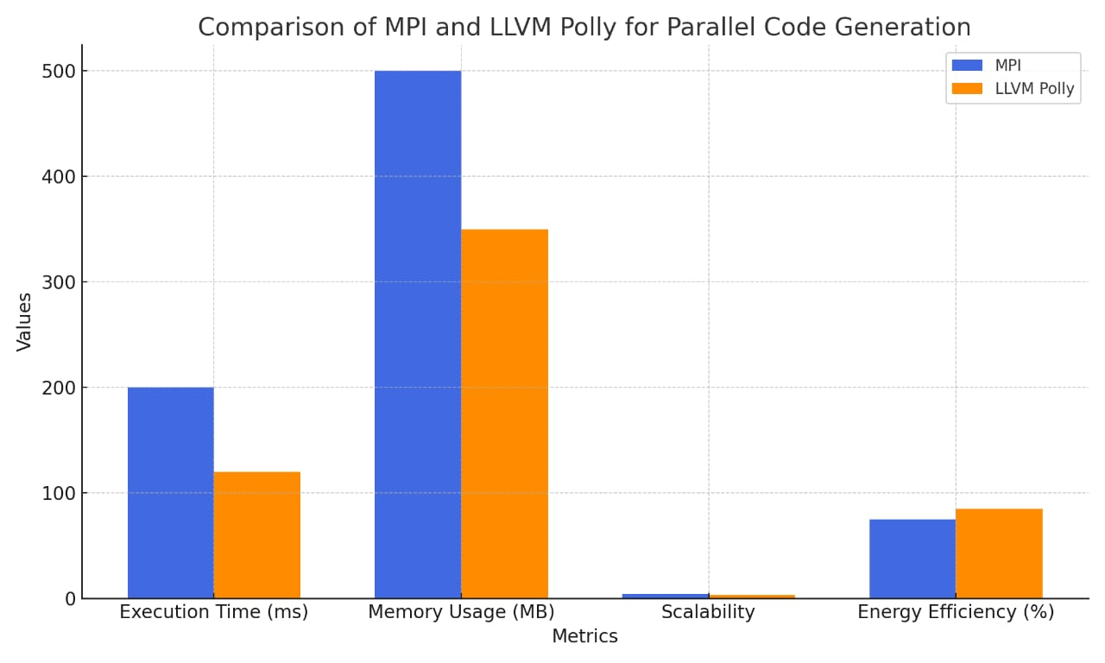
Results & Evaluation
Execution Time and Memory Usage: LLVM Polly demonstrates lower execution time and memory usage compared to MPI due to its advanced compiler-level optimizations.MPI, though efficient for large-scale distributed systems, may experience higher memory consumption due to explicit data communication across nodes.
Scalability :MPI excels in scalability for distributed memory systems, making it suitable for supercomputing applications .LLVM Polly, on the other hand, is more effective for optimizing shared-memory, multi-core CPU, and GPU systems, achieving notable speedup within a single machine.

Slide 13
Challenges & Limitations
Accurate dependency detection is complex.
Managing race conditions without affecting performance is difficult.
Scalability issues with large codebases.
Compatibility with legacy systems is limited.
Balancing speed and resource use is challenging.
Task scheduling may cause uneven load distribution.
Debugging parallel code is more complex than sequential code.

Slide 14
Future Scope
Enhanced Dependency Analysis: Improve accuracy in detecting and resolving complex dependencies.
Dynamic Optimization: Develop adaptive strategies for real-time task scheduling and load balancing.
Support for Heterogeneous Architectures: Extend compatibility to GPUs and other specialized processors.
AI Integration: Use machine learning to predict and optimize parallel execution patterns.
AI-Driven Optimization: Future compilers can use advanced AI models to enhance code parallelization and optimize performance in real-time.

Slide 15
Conclusion
In conclusion, this project demonstrates the effectiveness of modern compiler techniques in automating the generation of parallel code from sequential programs. By analyzing dependencies, resolving race conditions, and applying task scheduling, the system improves execution speed and resource utilization on multi-core processors.
The results show significant performance gains and enhanced scalability, highlighting the potential of automated parallelization. While challenges in complex dependency resolution and load balancing remain, the project establishes a solid framework for future improvements, including AI-driven optimization and support for diverse computing architectures.

Slide 16
References
Allen, R., & Kennedy, K. (2002). Optimizing Compilers for Modern Architectures: A Dependence-based Approach. Morgan Kaufmann.
Aho, A. V., Lam, M. S., Sethi, R., & Ullman, J. D. (2006). Compilers: Principles, Techniques, and Tools. Addison-Wesley.
Bacon, D. F., Graham, S. L., & Sharp, O. J. (1994). Compiler transformations for high-performance computing. ACM Computing Surveys, 26(4), 345-420.
Sura, Z., Chen, H., & Hirasawa, M. (2005). Automatic parallelization with OpenMP in the IBM XL compiler. International Journal of Parallel Programming, 33(2), 183-203.
Ayguadé, E., Badia, R. M., & Labarta, J. (2003). Exploiting parallelism through compiler optimization. Parallel Computing, 29(11-12), 1665-1684.
Adve, S. V., & Boehm, H. (2010). Memory models: A case for rethinking parallel languages and hardware. Communications of the ACM, 53(8),

Slide 17
THANK YOU!

